Slide 1
Using adaptive psychophysical methods to individualize studies involving Systems Factorial Technology
Joseph J. Glavan
glavan.3@wright.edu
Joseph W. Houpt
Wright State University

Slide 2
How are stimuli processed?
Multiple sources of information:
Color and shape
Facial features
Curved and straight text features
Multiple modalities

Slide 3
How are stimuli processed?
Serial:
Input A
AND / OR
To Response
Decision Threshold
PROCESSING
Input B
Decision Threshold
PROCESSING
Parallel:
Input A
Decision Threshold
PROCESSING
AND / OR
To Response
Input B
Decision Threshold
PROCESSING

Slide 4
Survivor Interaction Contrast
SIC(t) = [S_{LL}(t) – S_{LH}(t)] – [S_{HL}(t) – S_{HH}(t)]
Double Factorial Paradigm (DFP)
 | Feature B
Feature A | Saliency | High | Low | Absent
 | High | HH | HL | HA
 | Low | LH | LL | LA
 | Absent | AH | AL | AA

Slide 5
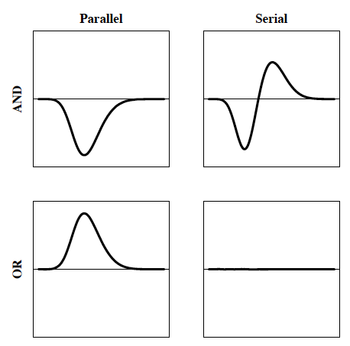

Slide 6
Selecting Saliency Levels
Using group level saliency levels is inefficient
Use individualized saliency levels to maximize data retention and statistical power

Slide 7
Psychophysics
Assumption: Lower saliency causes both lower accuracy and increased response times
Accuracy must still be high!
Procedure must be quick!

Slide 8
Adaptive Psychophysical Methods
Staircase
Levitt (1970) transformed method
Kaernbach’s (1991) weighted method
QUEST (Watson & Pelli, 1983)
Bayesian placement of Ψ
Slope is fixed by experimenter

Slide 9
Psi Method
Bayesian adaptive method
Minimizes entropy over location and slope
Kontsevich & Tyler (1999) report convergence at 30 (location) and 300 (slope) trials
Implemented in Python for use with PsychoPy libraries

Slide 10
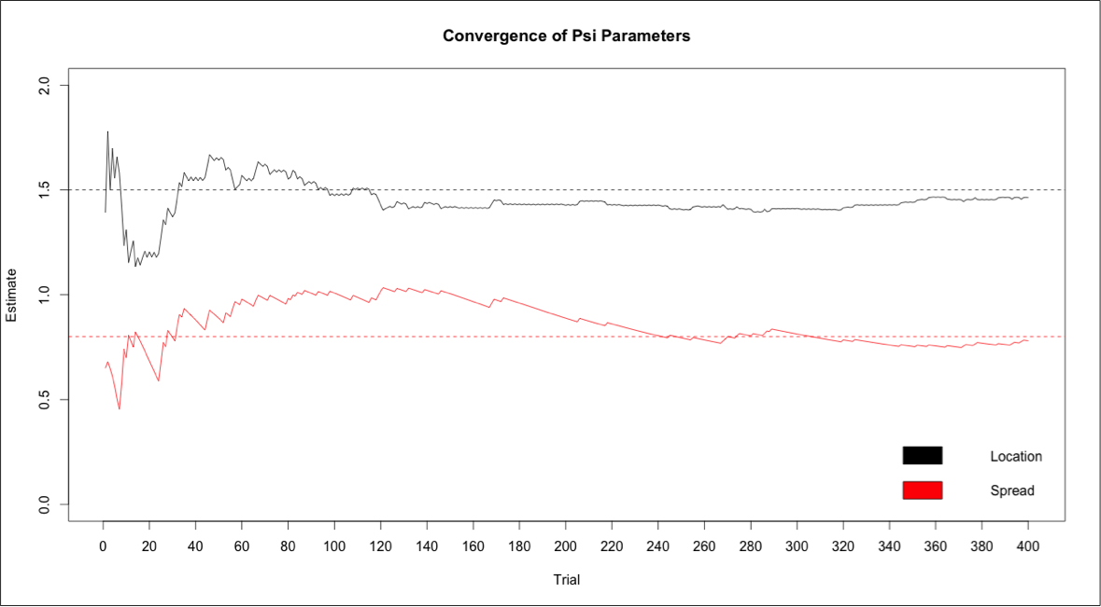
Simulations and Validations

Slide 11
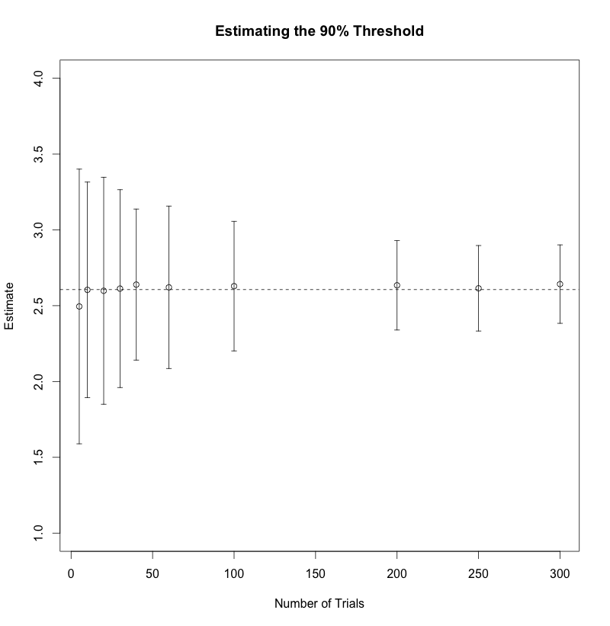
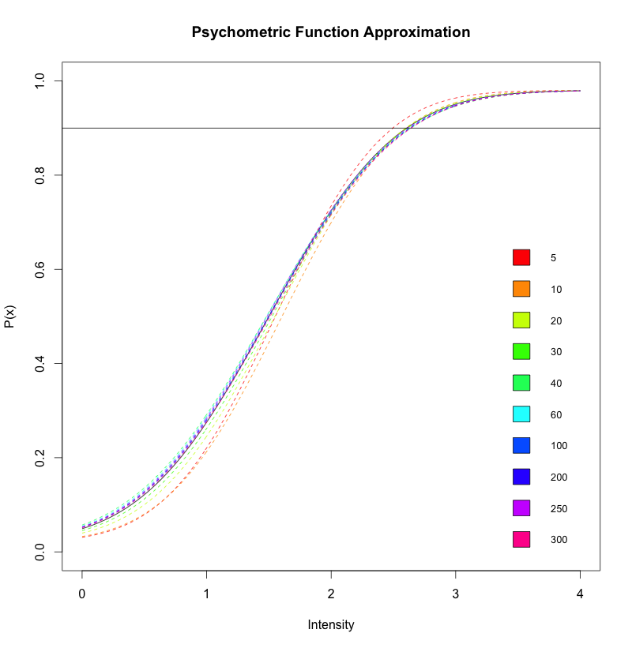
Simulations and Validations

Slide 12
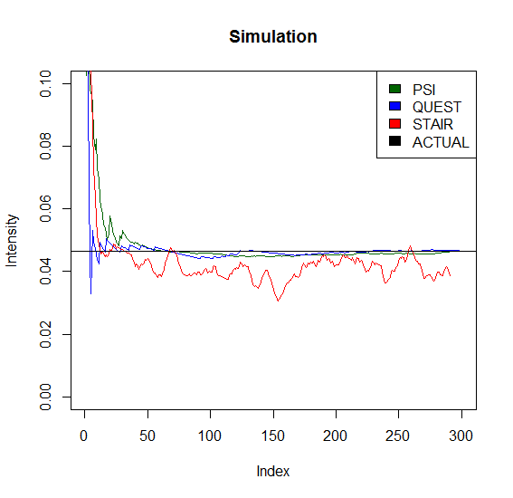
Simulations and Validations

Slide 13
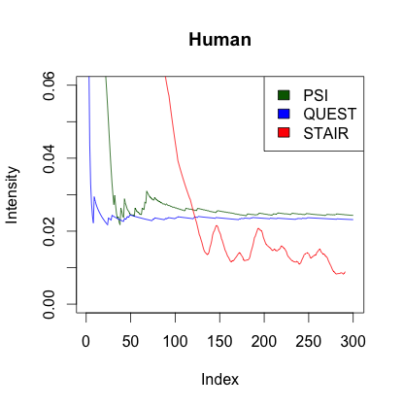

Slide 14
Experimental Design
Adaptive psychophysical pre-testing block
Psi (2*(10+30+30)*2.5s = ~6 min)
SIC experiment
Double Factorial Paradigm
PsychoPy
Analyze data
“sft” package for R

Slide 15
Future Work
Upcoming studies in our lab (audio-visual, multi-spectrum image fusion, visual search)
Get Psi package included in PsychoPy
Develop similar Python package using chronometric methods

Slide 16
References
Fific, M., Eidels, A.& Townsend, J. T. (2008). Studying visual search using systems factorial methodology with target–distractor similarity as the factor. Percept Psychophys, 70(4), 583-603.
Fifić, M., & Townsend, J.T. (2010). Information-processing alternatives to holistic perception: Identifying the mechanisms of secondary-level holism within a categorization paradgm. Journal of Experimental Psychology: Learning, Memory, and Cognition. 36(5), 1290-1313.
Houpt, J.W., Blaha, L.M., McIntire, J.P., Havig, P.R., and Townsend, J.T. (2013). Systems factorial technology with R. Behavior Research Methods.
Kaernbach, C. (1991). Simple adaptive testing with the weighted up–down method. Perception & Psychophysics, 49, 227-229.
Kontsevich, L. L., & Tyler , C. W. (1999). Bayesian adaptive estimation of psychometric slope and threshold. Vision Research, 39, 2729-2737.
Levitt, H. (1971). Transformed up–down methods in psychoacoustics. Journal of the Acoustical Society of America, 49, 467-477.
Peirce, J. W. (2007). PsychoPy – psychophysics software in Python. Journal of Neuroscience Methods, 162(1), 8-13.
Townsend, J. T. & Nozawa, G. (1995). Spatio-temporal properties of elementary perception: An investigation of parallel, serial and coactive theories. Journal of Mathematical Psychology, 39, 321-360.
Watson, A. B., & Pelli, D. G. (1983). QUEST: A Bayesian adaptive psychometric method. Perception & Psychophysics, 33, 113-120.

Slide 17
Questions?
This work funded by AFOSR grant FA9550-13-1-0087.
Contact: Joe Glavan glavan.3@wright.edu
Look for Psi in PsychoPy soon!

