Slide 1
Exploring the Time-Based Resource-Sharing Model through Computational Modeling
Joseph Glavan
Joseph Houpt
Wright State University
August 7, 2016

Slide 2
Purpose
The Time-Based Resource-Sharing (TBRS) model is a mostly verbal model of working memory
Formalize into an end-to-end computational model (using ACT-R)
Highlight ancillary assumptions
Identify experiments to test these assumptions and further constrain the theory
Barrouillet, Bernardin & Camos (2004); Oberauer & Lewandowsky (2011)
Notes:
*They make one quantitative prediction (later) and Oberauer & Lewandowsky (2011) made a connectionist model (combining work from Burgess & Hitch with accumulator models)
Modeling effort identifies future experiments while the model itself provides a launching point for investigating them

Slide 3
TBRS Model
3
Attention is needed for maintenance and processing
Central bottleneck
Temporal decay
Rapid switching between maintenance and processing
Barrouillet, Bernardin & Camos (2004)
Notes:
These are the core assumptions built into my model

Slide 4
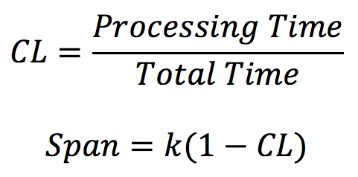
Cognitive Load
4
k = raw WM capacity (unique to individual, task, etc.)
Barrouillet, Portrat & Camos (2011)
Notes:
This is the quantitative prediction demonstrated on the next slide
k is a free parameter of the linear model which is fit to individuals/task
----- Meeting Notes (8/2/16 14:15) -----
Practice this more so the words are automatic

Slide 5
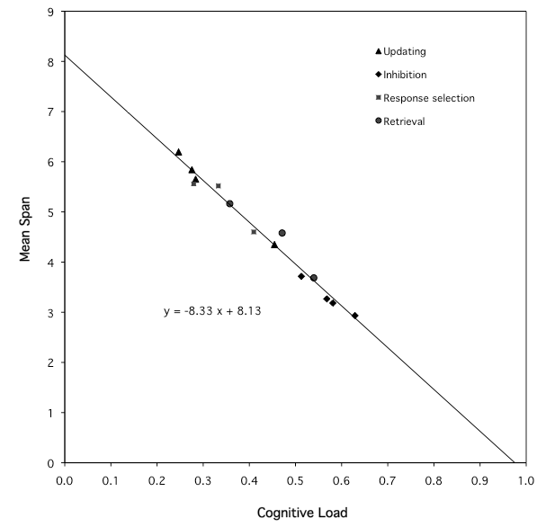
5
Y = -8.33 * X + 8.13
R² = .98
Barrouillet, Portrat & Camos (2011)
Notes:
Data from 14 different experimental conditions
Point out k

Slide 6
The Task
6
Barrouillet et al. (2007) – Experiment 3
Designed to compare effects of different sources of CL
Six between-subjects conditions
2 CL sources (retrievals vs response selection)
3 paces of distractors
Trained on 96 judgment trials and 1- and 2-letter sets
Recall
*
b
7
delay
500 ms
delay
500 ms
Next target
750 ms
1500 ms
6400 ms
Notes:
Be sure to mention training and the decision regarding metacognition
Number presented / Delay / Total Time
4: 1,067 ms / 533 ms / 1,600 ms
6: 711 ms / 356 ms / 1,067 ms
8: 533 ms / 267 ms / 800 ms
----- Meeting Notes (8/2/16 14:15) -----
This is one of the tasks from this slide

Slide 7
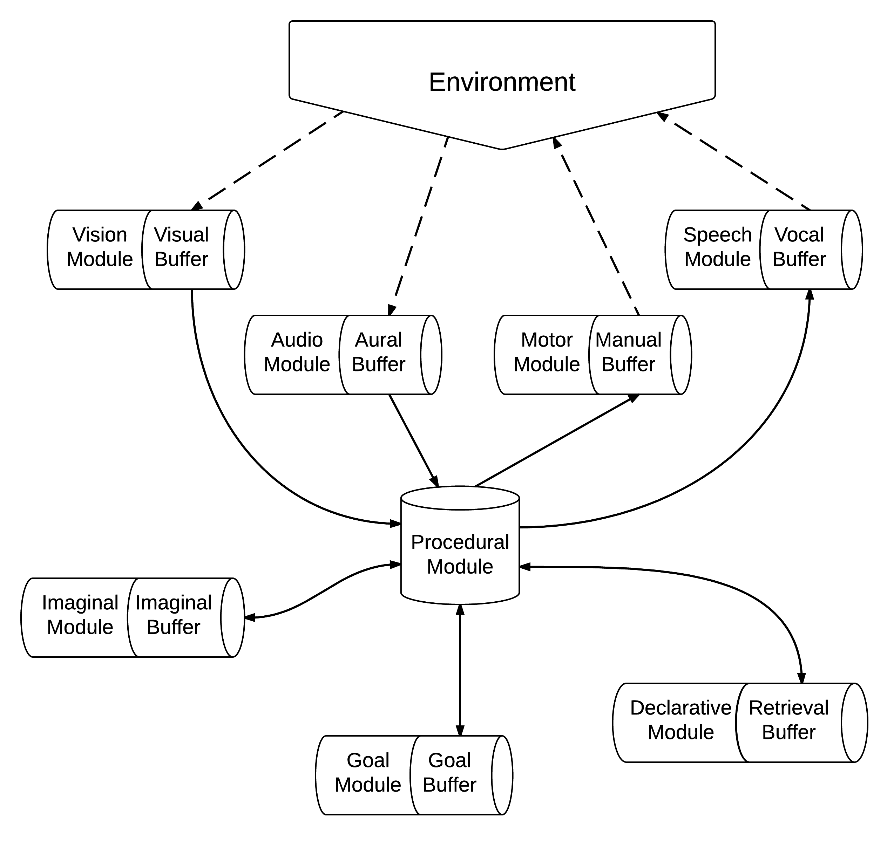
ACT-R
7
Notes:
As brief as possible
Emphasize bottleneck(s) and perception/action modules allow for end-to-end modeling

Slide 8
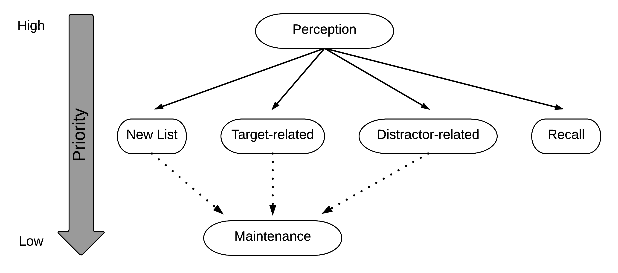
Model Behavior
8
Notes:
Super quick overview of what the model does
Emphasize that hard constraints and how maintenance implements the rapid switching mechanism

Slide 9
Model Behavior
9
List order preserved through
Episodic similarity
Temporal inhibition
Notes:
Super quick overview of what the model does
Emphasize that hard constraints and how maintenance implements the rapid switching mechanism

Slide 10
Model Results
10
Notes:
Transition slide

Slide 11
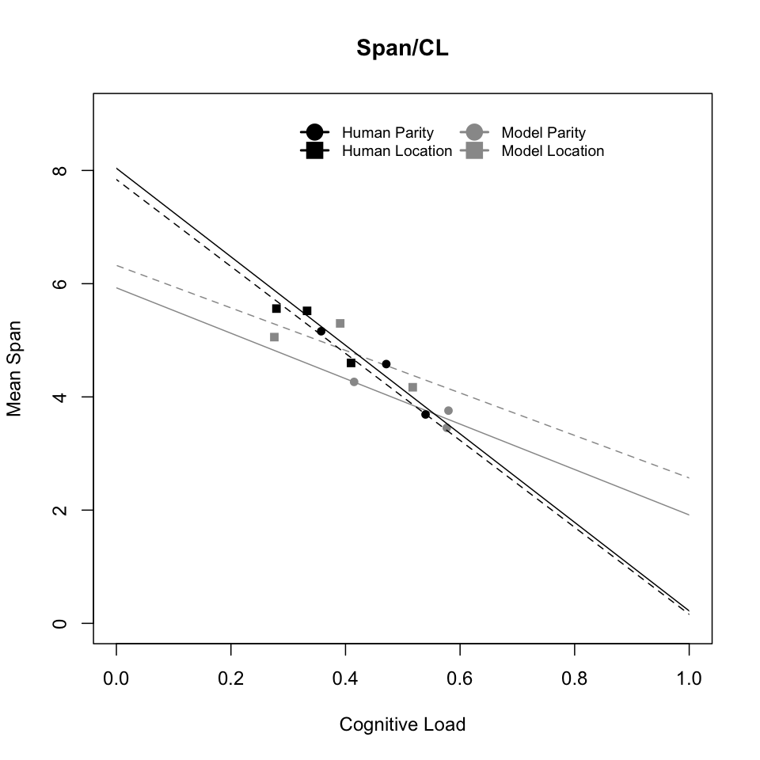
11
Notes:
Able to capture the relationship between these two variables although the quantitative fit to the points isn’t great (see next slide)

Slide 12
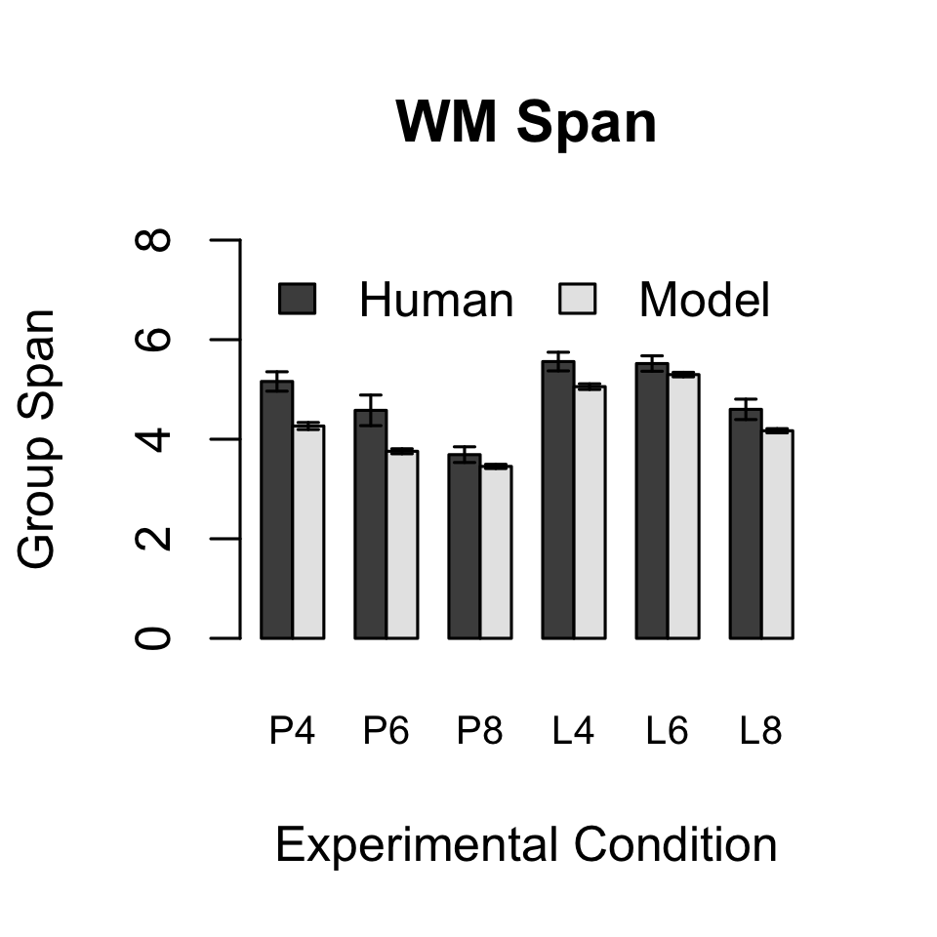
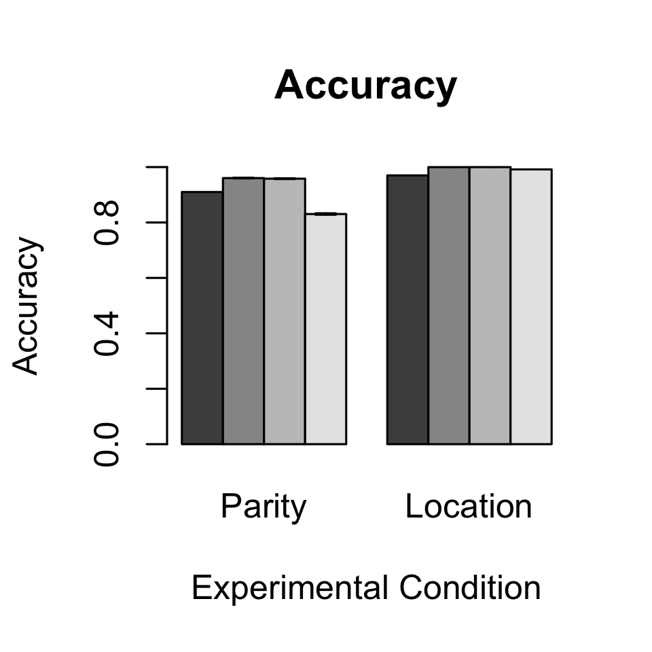
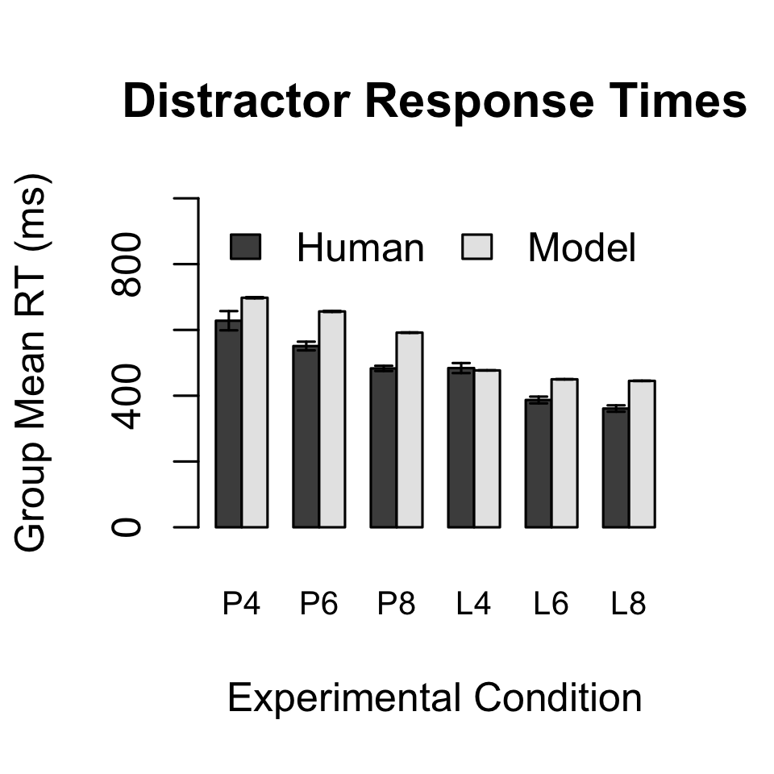
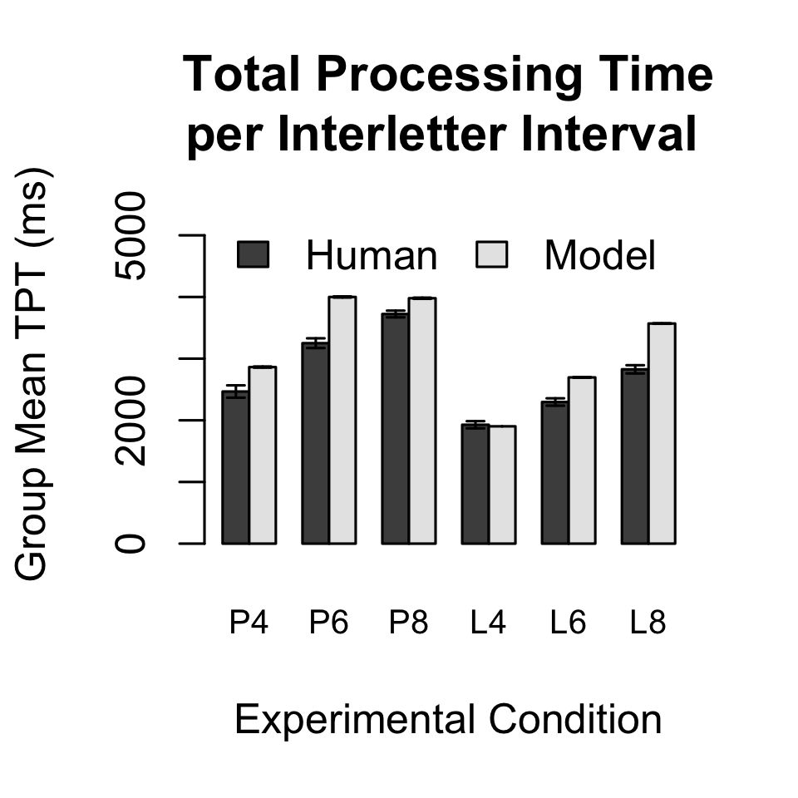
12
Notes:
Look we can replicate trends in other DVs as well

Slide 13
Discussion
13
Good qualitative fit, poor quantitative fit
List representation underspecified in TBRS
Serial position effects/errors
Self-generated reinforcement inflates CL
Non-attentional mechanisms (articulatory rehearsal)
Camos & Barrouillet (2014)
Notes:
Given existing empirical data supporting TBRS, as well as Oberauer & Lewandowsky’s in-depth examination of the fundamentals of the refreshing mechanism, the fact that we can capture the trends indicates that the core assumptions of TBRS work, but the ancillary assumptions may not be correct

Slide 14
Future Work
14
Explore full range of CL within-subjects
Compare temporal decay and representational interference using ACT-R
General attentional refreshing routine for ACT-R
Can use the model to measure CL in applied settings
Notes:
This was a first step trying to bring multiple things together. Now that we have this first version of the model, additional steps could be...
INDIVIDUAL DIFFERENCES
Model comparison of opposing theories
Expand model to other scenarios to further validate the refreshing mechanism
CL is easy to measure in lab settings

Slide 15
Questions?

Slide 16
References
Anderson, J. R., Bothell, D., Byrne, M. D., Douglass, S., Lebiere, C., & Qin, Y. (2004). An integrated theory of the mind. Psychological review, 111(4), 1036.
Barrouillet, P., Bernardin, S., & Camos, V. (2004). Time constraints and resource sharing in adults' working memory spans. Journal of Experimental Psychology: General, 133(1), 83.
Barrouillet, P., Bernardin, S., Portrat, S., Vergauwe, E., & Camos, V. (2007). Time and cognitive load in working memory. Journal of Experimental Psychology: Learning, Memory, and Cognition, 33(3), 570.
Barrouillet, P., Portrat, S., Camos, V. (2011). On the law relating processing to storage in working memory. Psychological Review, American Psychological Association, 118 (2), pp.175-92.
Camos, V., & Barrouillet, P. (2014). Attentional and non-attentional systems in the maintenance of verbal information in working memory: the executive and phonological loops. Frontiers in Human Neuroscience, 8, 900. doi:10.3389/fnhum.2014.00900
Oberauer, K., & Lewandowsky, S. (2011). Modeling working memory: a computational implementation of the time-based resource-sharing theory. Psychonomic Bulletin & Review, 18(1), 10-45.

Slide 17
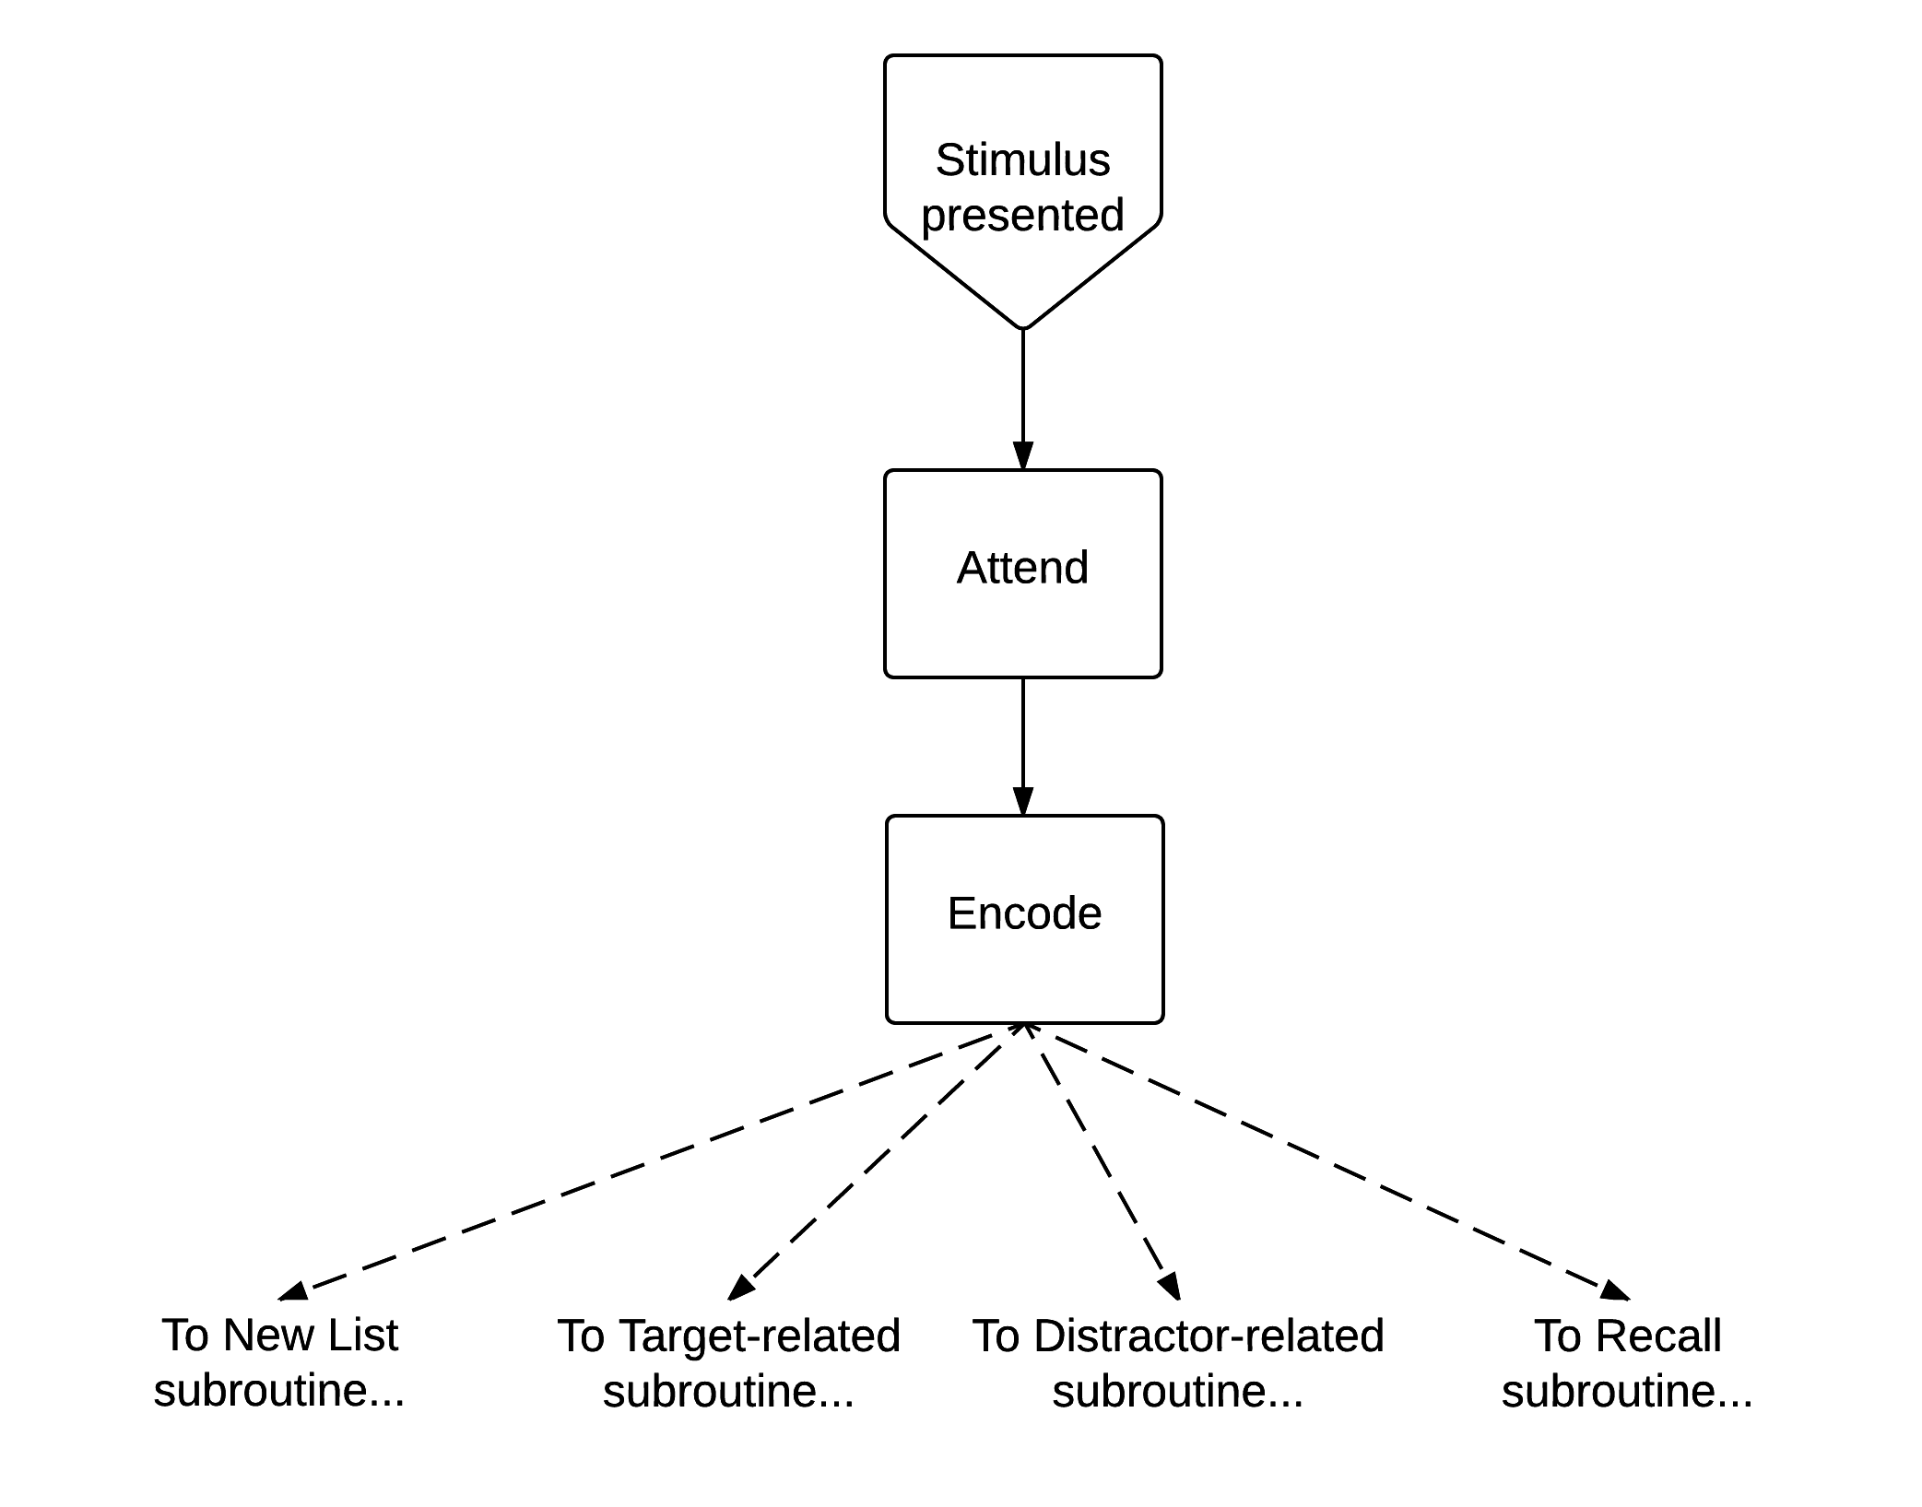
Perception Subroutine
Notes:
By encode, I mean retrieve the semantic representation
The type of the chunk retrieved (4 possible) determines where it goes next
Asterisk retrieved; Letter retrieved; Number retrieved*; “Recall” retrieved

Slide 18
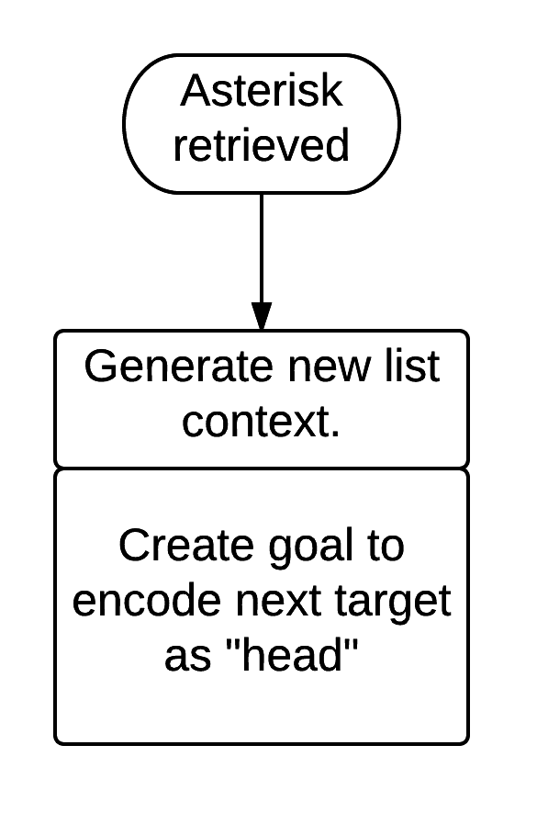
New-List Subroutine
Notes:
New list context is just a unique string, but this could be changed in future models

Slide 19
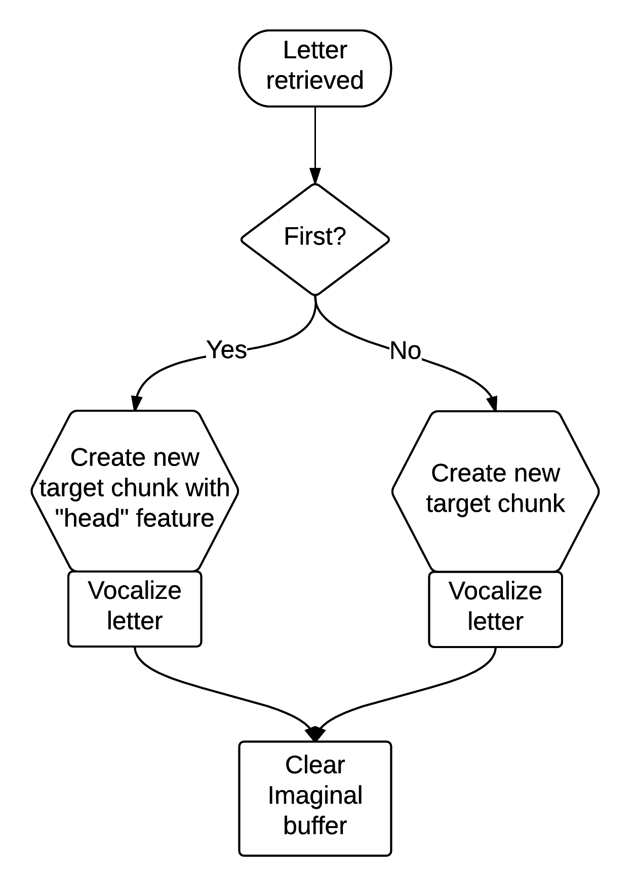
Target-Related Subroutine
Example Target Chunk
Chunk Name: |  | TARGET1-0
Chunk Type: |  | target
Chunk Slots (features) | string | “c”
 | parent | start
 | list | “1000”
 | episode | 1.941
Notes:
Target chunk is the episodic representation of the target
Episode is the absolute experiment time via haxx. A more principled method would be to use the temporal module.
----- Meeting Notes (3/28/16 13:51) -----
Might consider using a chunk instead of string for text representation

Slide 20
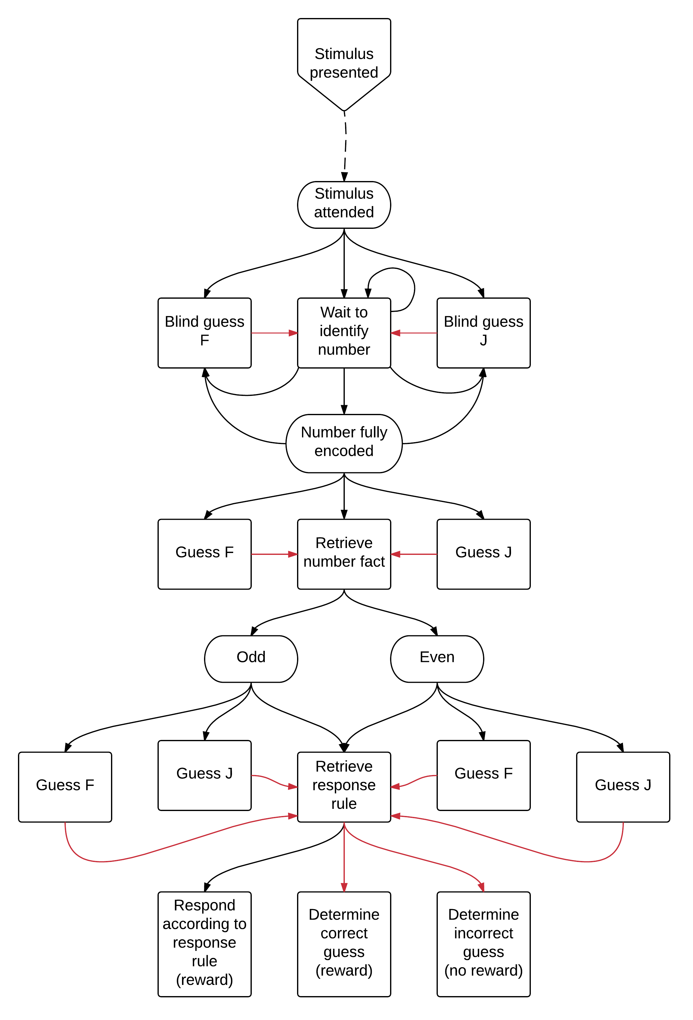
Distractor-Related Subroutine:
Parity condition
Notes:
If the model guesses then it is forced down the quickest path to retrieving the response rule and evaluating its response.

Slide 21
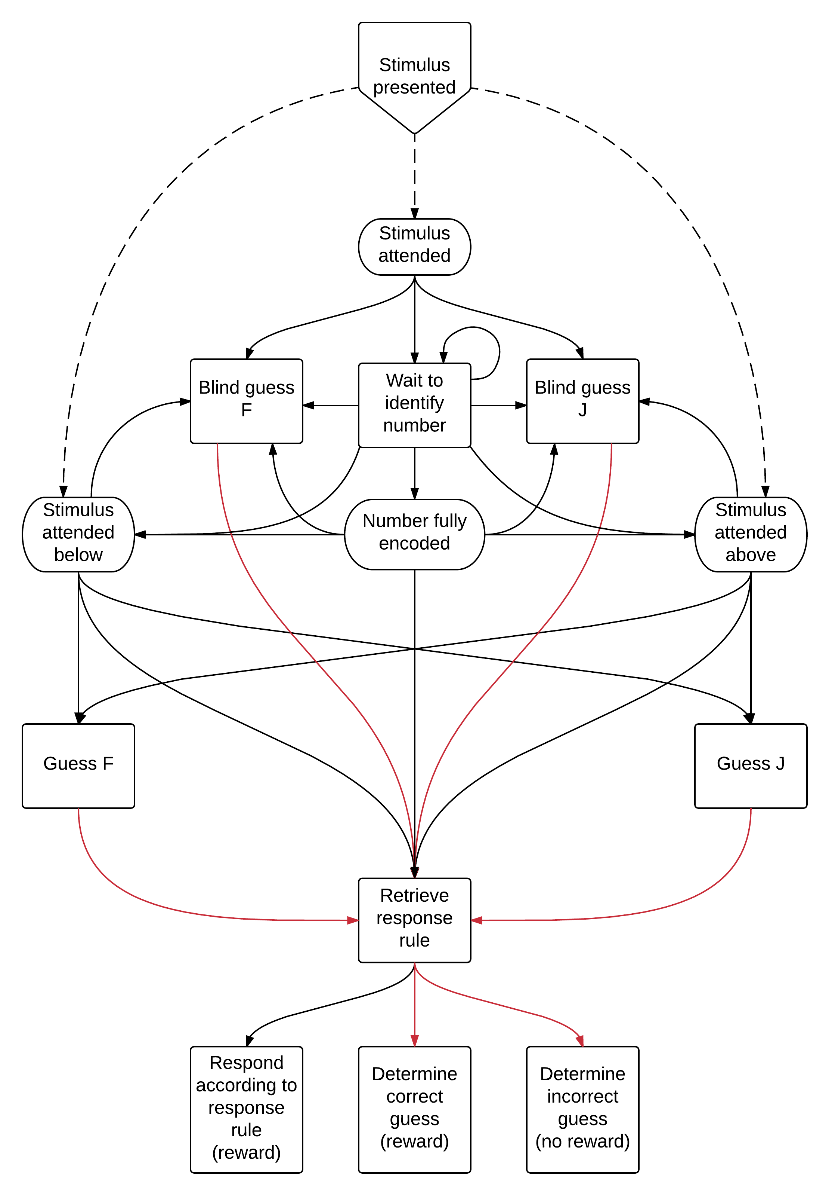
Distractor-Related Subroutine:
Spatial-location condition
Notes:
If the model guesses then it is forced down the quickest path to retrieving the response rule and evaluating its response.
----- Meeting Notes (3/28/16 13:51) -----
Typo: arrow from encoded to response rule shouldn't be there

Slide 22
Procedural Learning Mechanisms
Utility learning
Responsible for learning the correct response
U_{i}(n) = U_{i}(n-1) + α [R_{i} – U_{i}(n-1)]
Production compilation
Responsible for learning to respond faster
Bypass retrievals
Notes:
Ri is the raw reward received (a free parameter) minus the time since production I fired

Slide 23
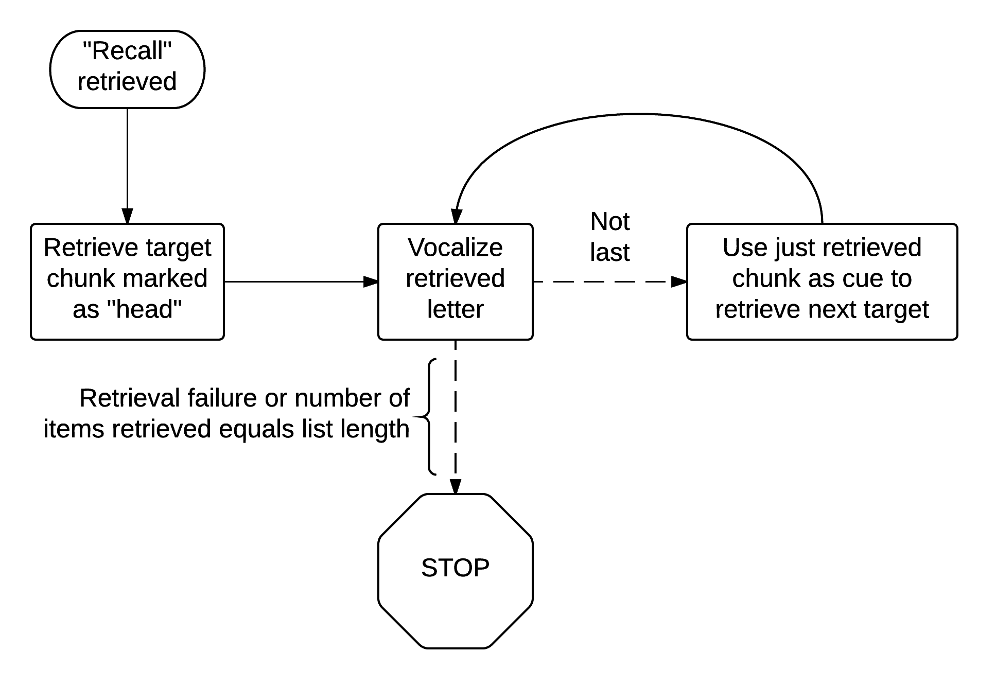
Recall Subroutine
Notes:
----- Meeting Notes (3/28/16 13:51) -----
List context is also used

Slide 24
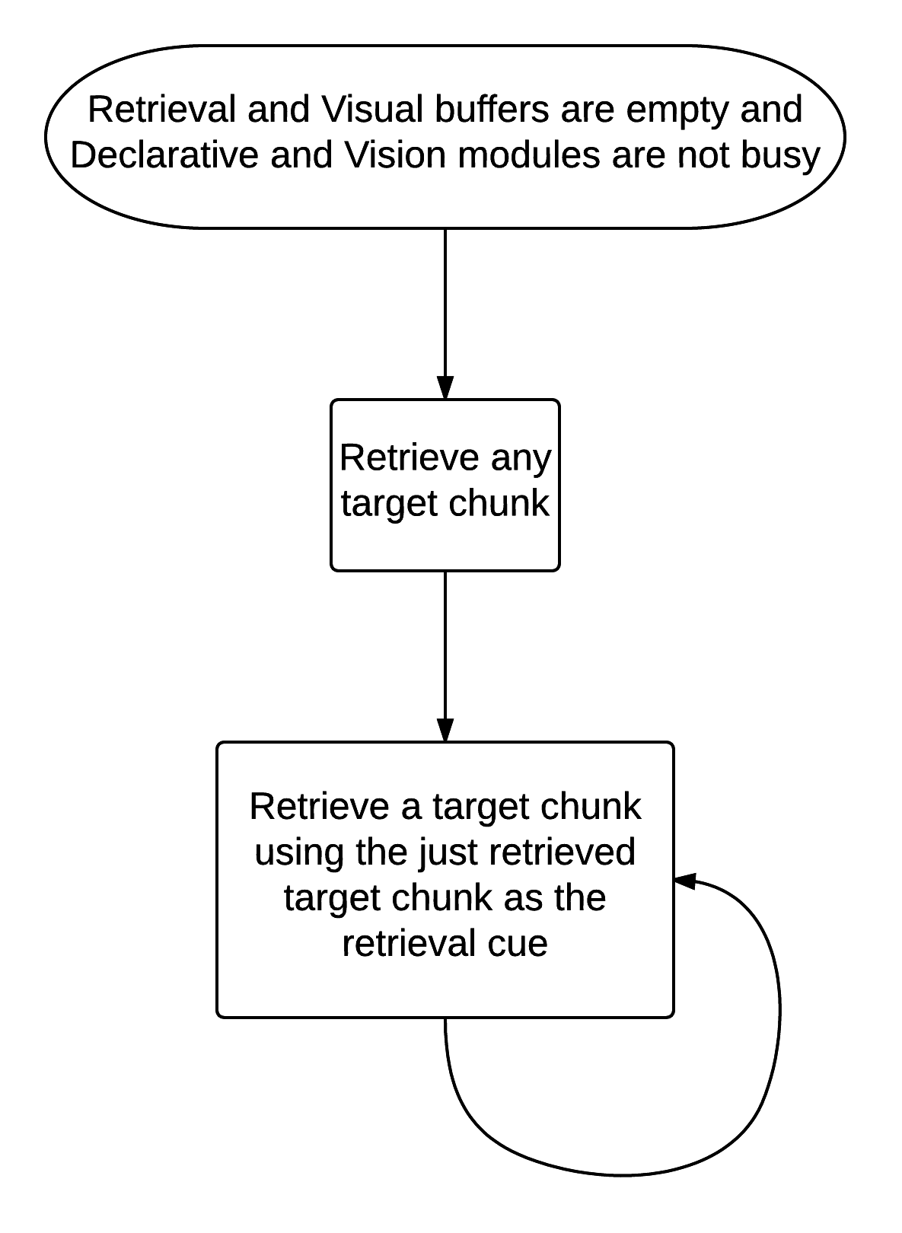
Maintenance Subroutine

Slide 25
Retrieval Equations

Slide 26
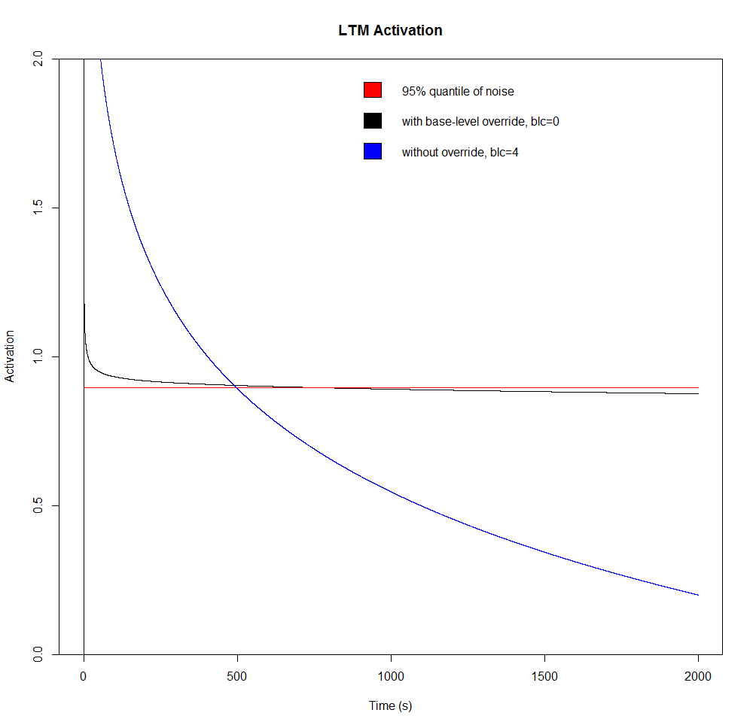
Stable LTM Assumption
Notes:
Used set-base-levels function to stabilize the activation of certain (i.e. non-target) chunks

Slide 27
Model Parameters
Fixed
Free
Learning rate = .2
Utility noise = 1
Base-level decay = .5
Inhibition-scale = 1
Association scale = 1
Activation noise = .3
Retrieval threshold = 0
Reward ( R )
Inhibition-decay (γ)
Base-level constant (β)
Episodic selectivity (η)
Latency-exponent ( f )
Latency-factor ( F )
Notes:
If association scale is set to the interletter interval, then the model becomes equivalent to positional encoding
Activation noise comes from median value on Max Planck website
Retrieval threshold set to 0 for simplicity, plus this turns LF into the latency of failed retrievals

Slide 28
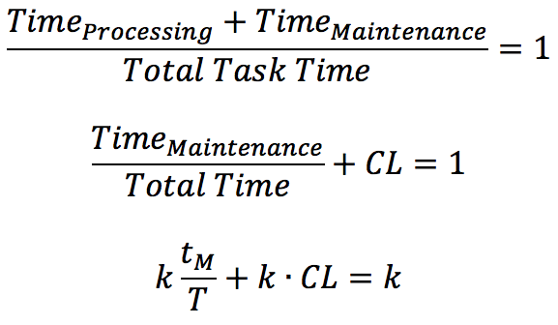
Predictions of Span
Barrouillet et al., 2007; Barrouillet, Portrat & Camos, 2011
Notes:
----- Meeting Notes (12/7/15 13:34) -----
Give examples of complex span because these terms are sort of task dependent

Slide 29
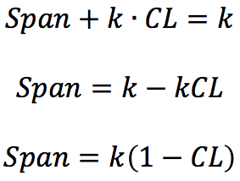
Predictions of Span
Barrouillet et al., 2007; Barrouillet, Portrat & Camos, 2011

