Slide 1
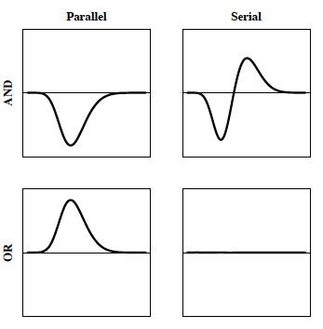
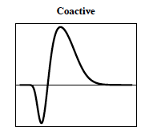
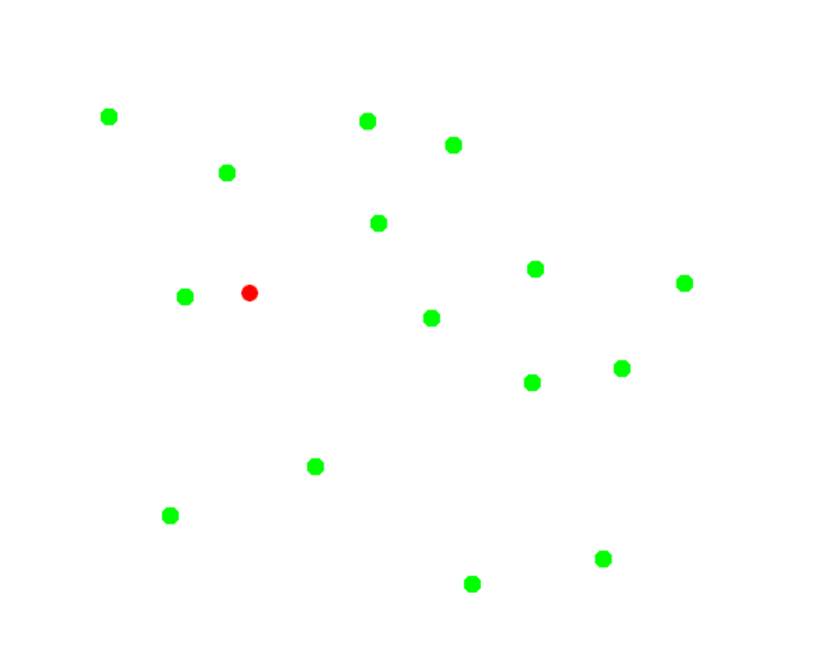
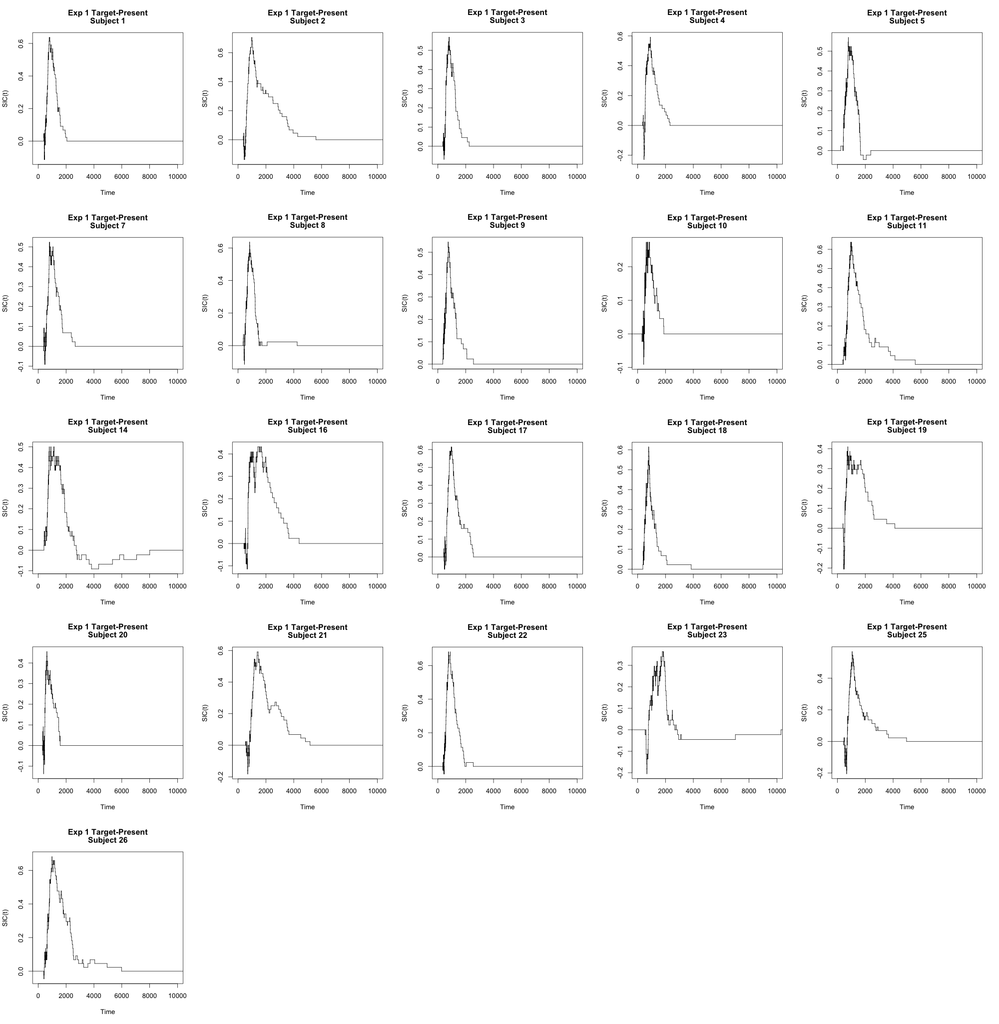
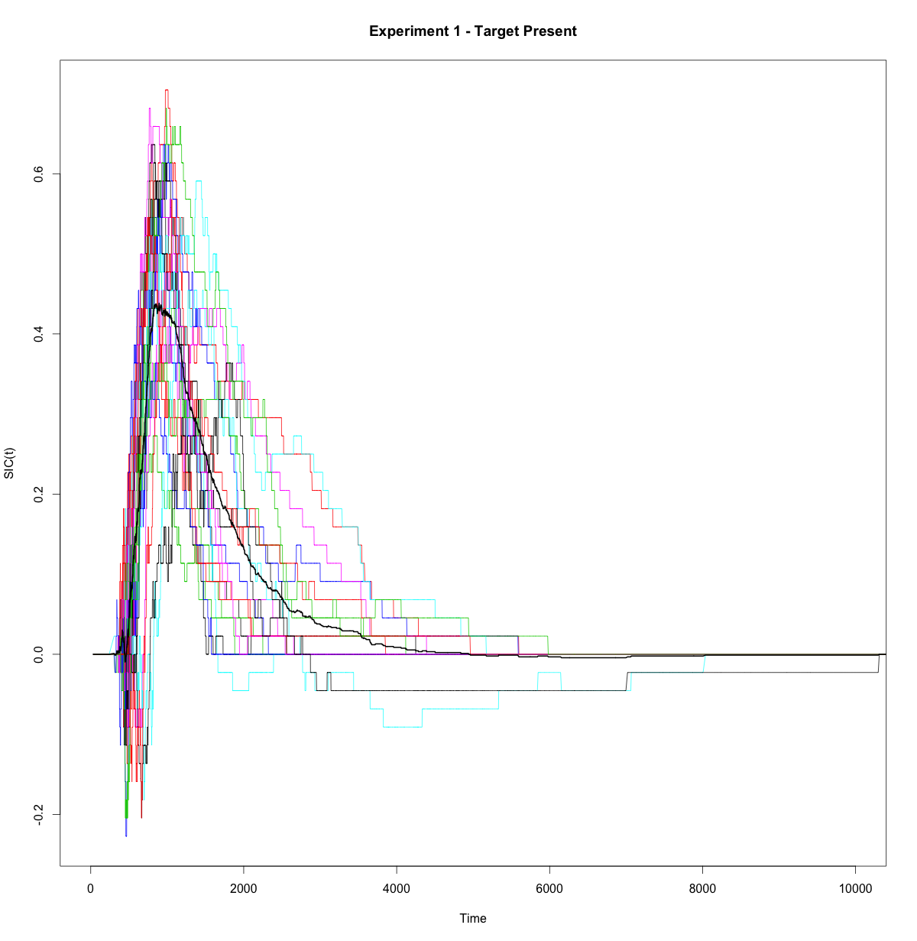
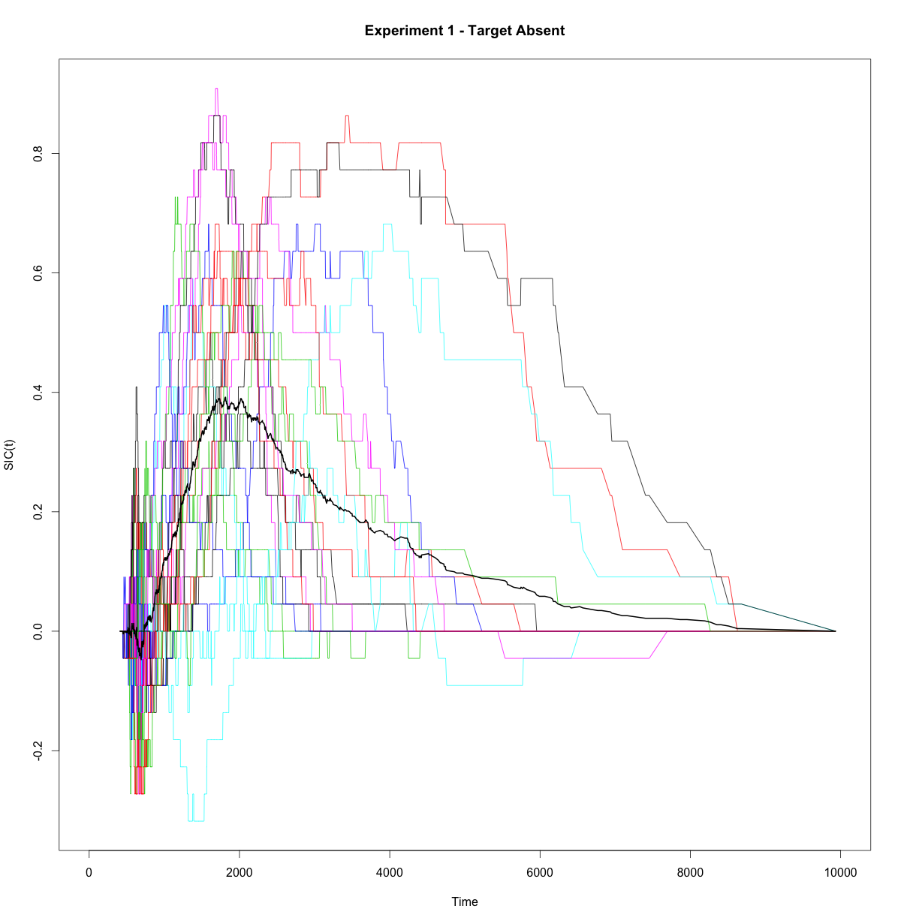
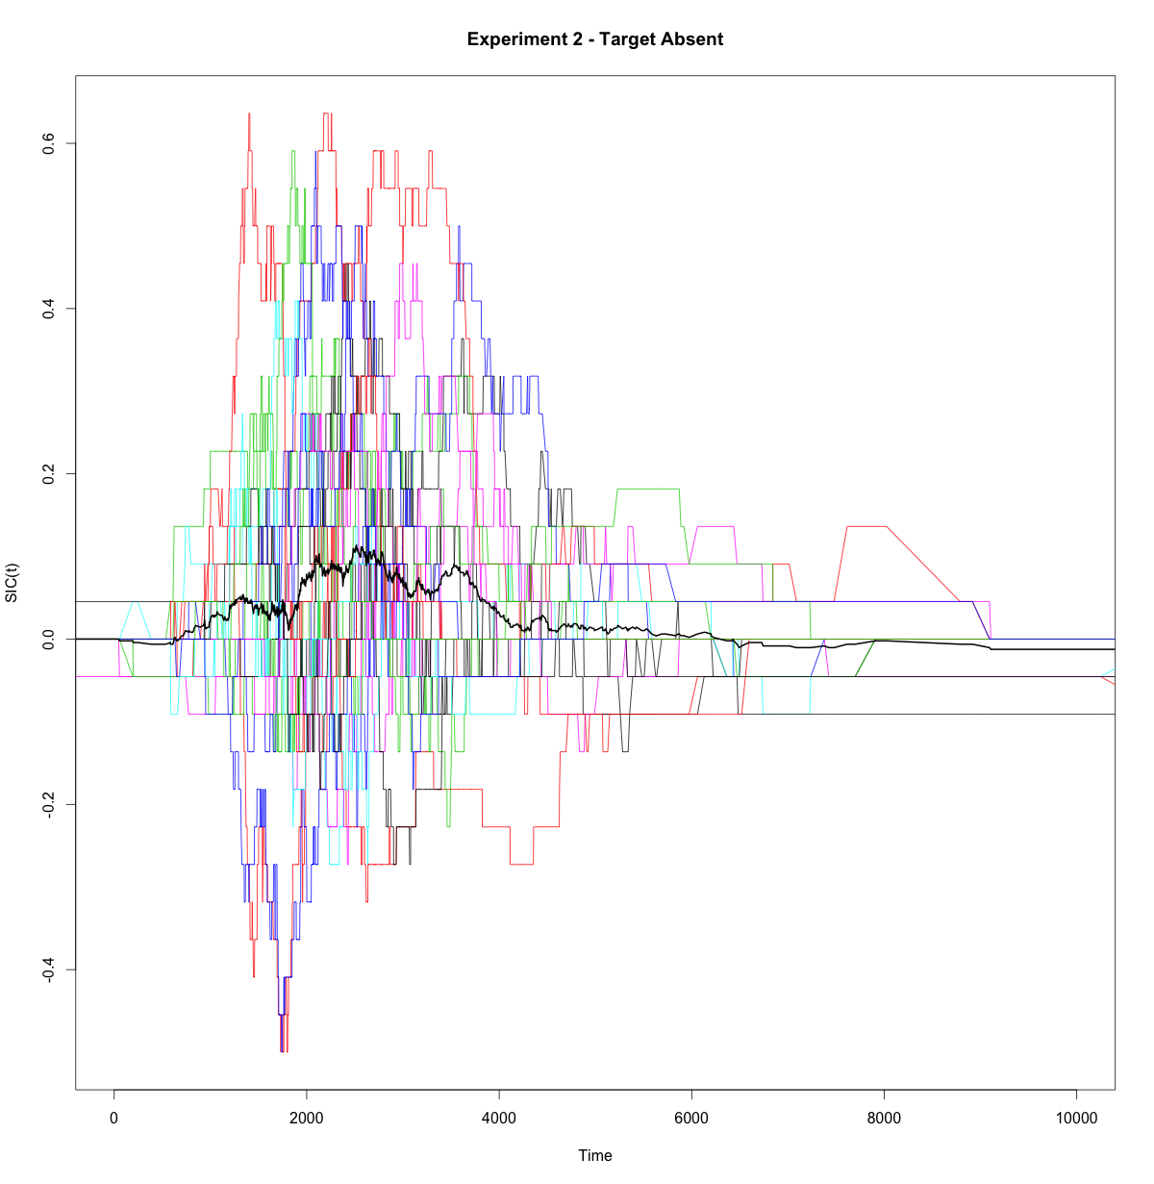
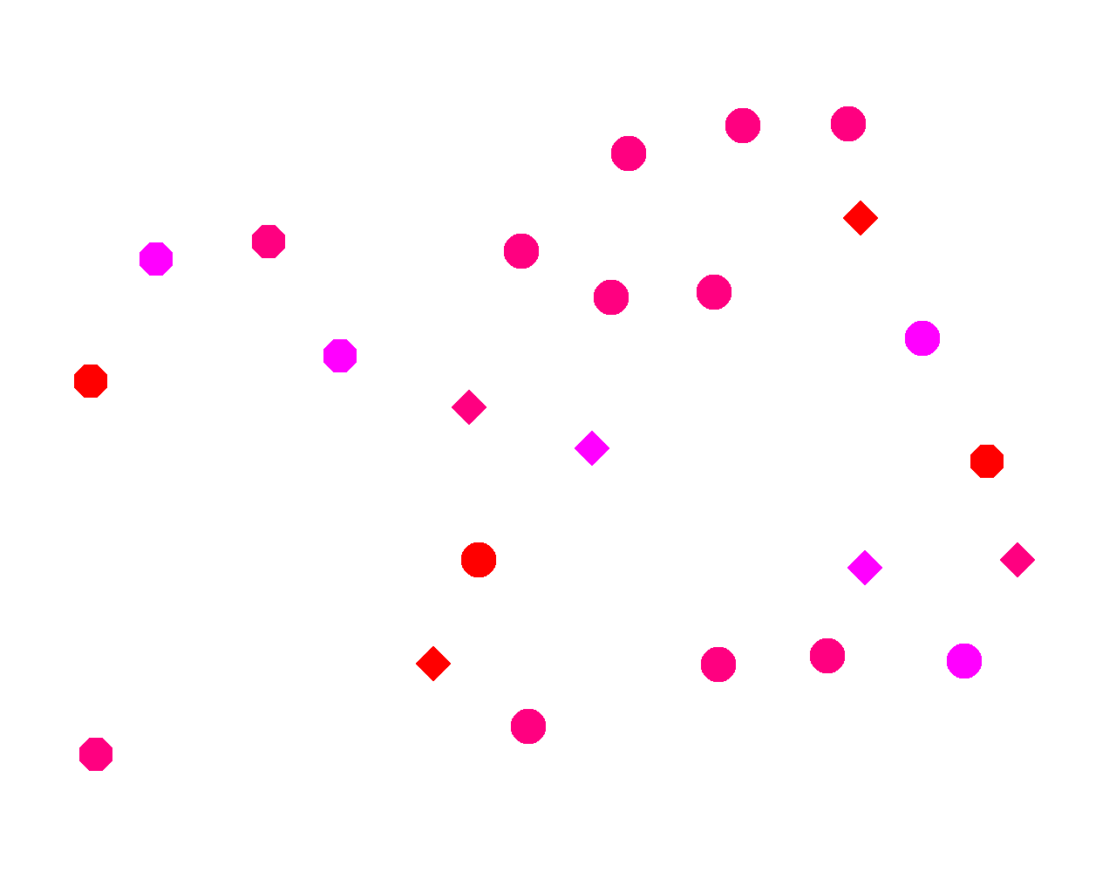
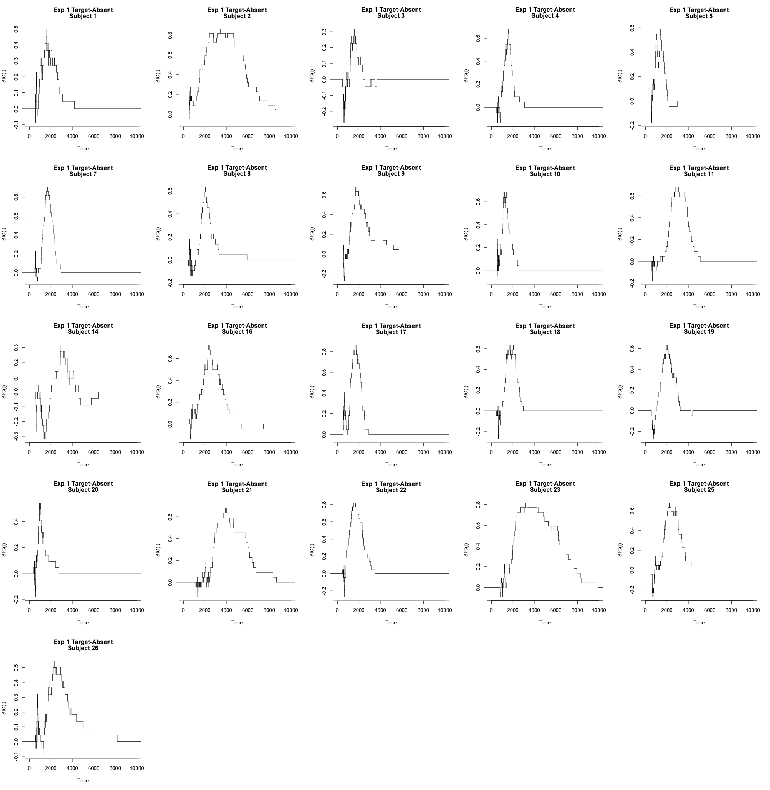
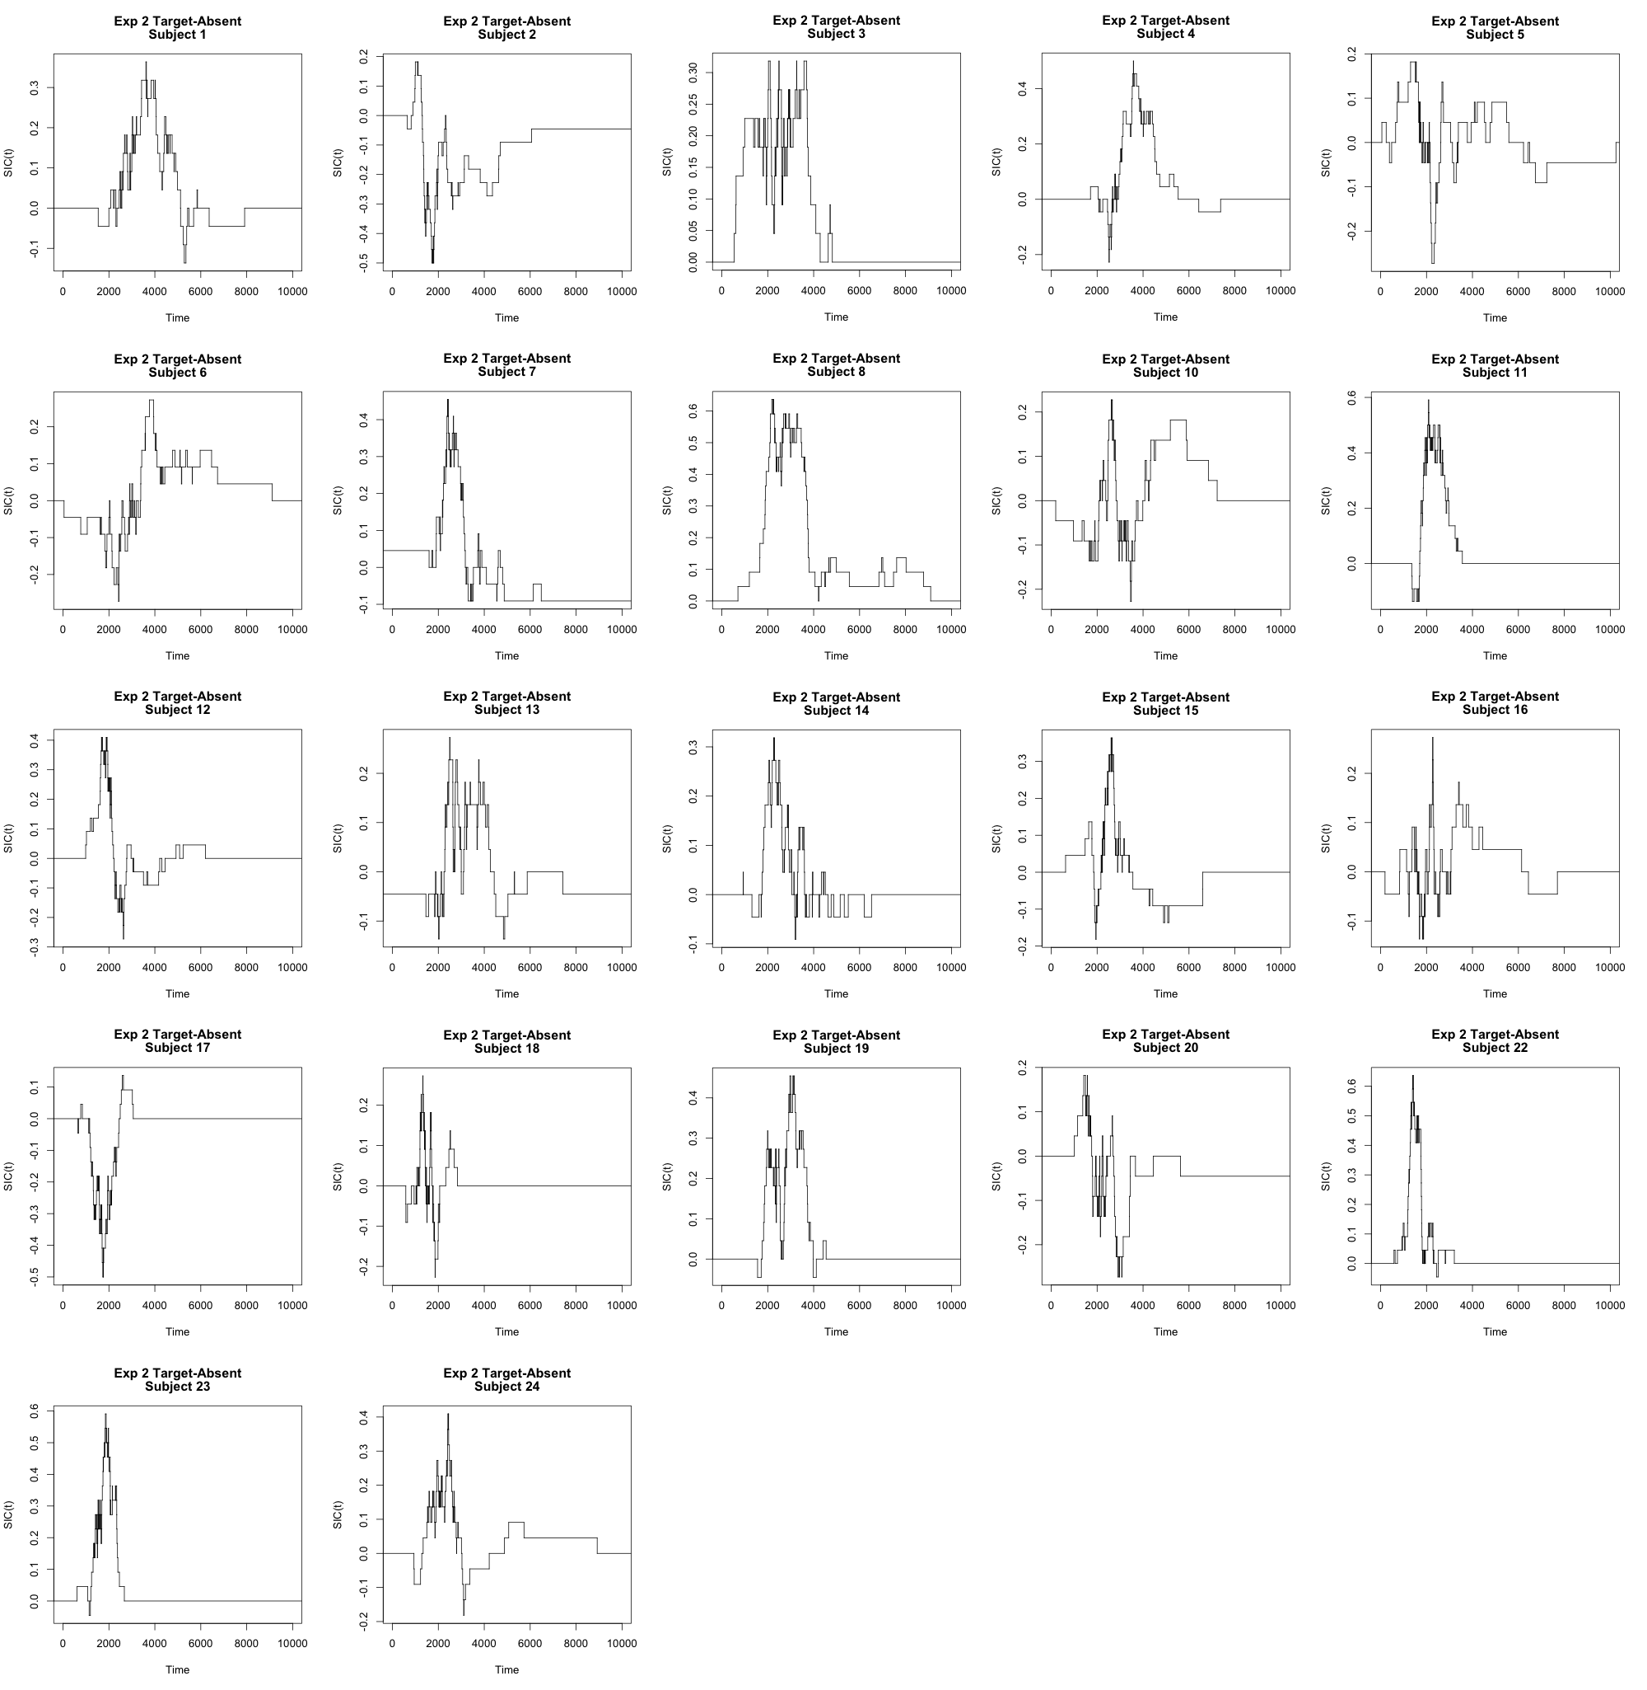
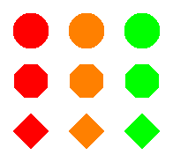
Evidence for Parallel Processing in the Identification of Shape and Color During Visual Search
Joseph J. Glavan Joseph W. Houpt
Wright State University, Dayton, Ohio
Introduction
Methods
Survivor Interaction Contrast^{4,5}
Conclusions
Traditional visual search paradigms use search slope (RT per distractor set size) to infer serial or parallel, but this confounds workload^{1,2}
Findlay found no evidence for or against serial, within-fixation processing of shape and color³
How does the combination of stimulus features (shape and color) affect the overall search process?
Systems Factorial Technology⁴ is a statistical framework for assessing serial/parallel, stopping rule, and workload at group and individual levels for cognitive processes that combine at least two sources of information
21 participants in Experiment 1
22 participants in Experiment 2
704 trials, target present on ¾ of trials
Participants asked to make a yes/no response if target (red circle) was present
SIC(t) = [S_{LL}(t) – S_{LH}(t)] – [S_{HL}(t) – S_{HH}(t)]
Decisive evidence against serial processing in Experiment 1
Results from Experiment 2 are unclear
Considering the results from Experiment 1, there may not have been enough target-absent trials
How could participants remain highly accurate in the task while using first-terminating (OR) processing?
The next round of experiments:
More trials (both overall and in the target-absent condition)
The Capacity Coefficient^{4,5} may help distinguish between parallel-OR and coactive processing
Eye Tracking
S(t) = 1 – CDF(t)
H:= High Saliency; L:= Low Saliency
Results
Accuracy was high (~97%) for all participants
Response times analyzed using SIC
Experiment 1
Experiment 2
19 of 21 significantly “Parallel-OR”
(target-present trials)
17 of 21 significantly “Parallel-OR”
(target-absent trials)
4 of 22 significantly “Parallel-OR”
(target-absent trials)
1 of 22 significantly “Parallel-AND”
(target-absent trials)
Experimental Design
Experiment 1: homogeneous distractors
Experiment 1 – Target Present Trials
Group Means
Experiment 2: heterogeneous distractors
References
Wolfe, J. M. (1998). What can 1 million trials tell us about visual search?. Psychological Science, 9(1), 33-39.
Townsend, J. T. (1971). A note on the identifiability of parallel and serial processes. Perception and Psychophysics, 10, 161–163.
Findlay, J. M. (1997). Saccade target selection during visual search. Vision Research, 37(5), 617-631.
Townsend, J. T., & Nozawa, G. (1995). Spatio-temporal properties of elementary perception: An investigation of parallel, serial and coactive theories. Journal of Mathematical Psychology, 39, 321-360.
Houpt, J. W., Blaha, L. M., McIntire, J. P., Havig, P. R., & Townsend, J. T. (2014). Systems factorial technology with R. Behavioral research methods, 46(2), 307-330.
Experiment 1 – Target Absent Trials
Experiment 2 – Target Absent Trials
Stimuli Sets
Experiment 1 Experiment 2
Acknowledgements
This work funded by AFOSR grant FA9550-13-1-0087.

